Slide 1
Final Project
Yelp Recommendation System Using Text Analytics
Data Science with Python
TEAM 8
Jayanth Chava (001899072)
Suraj Ghule (001824113)
Ashwin George (001846866)
Notes:
This template can be used as a starter file for presenting training materials in a group setting.
Sections
Right-click on a slide to add sections. Sections can help to organize your slides or facilitate collaboration between multiple authors.
Notes
Use the Notes section for delivery notes or to provide additional details for the audience. View these notes in Presentation View during your presentation.
Keep in mind the font size (important for accessibility, visibility, videotaping, and online production)
Coordinated colors
Pay particular attention to the graphs, charts, and text boxes.
Consider that attendees will print in black and white or grayscale. Run a test print to make sure your colors work when printed in pure black and white and grayscale.
Graphics, tables, and graphs
Keep it simple: If possible, use consistent, non-distracting styles and colors.
Label all graphs and tables.

Slide 2
About Yelp
Yelp is a crowd-sourced review forum
American multinational corporation headquartered in San Francisco, California
Yelp was founded in 2004 by former PayPal employees Russel Simmons and Jeremy Stoppelman
It develops, hosts and markets Yelp.com and the Yelp mobile app, which publish crowd-sourced reviews about local businesses, as well as the online reservation service Yelp Reservations. The company also trains small businesses in how to respond to reviews, hosts social events for reviewers, and provides data about businesses, including health inspection scores.

Slide 3
Datasets Used
CSV files :-
Yelp reviews
Yelp businesses
Yelp users
Yelp tips
JSON Files :-(It has extra attributes to better classify recommendation engine)
Reviews
Business
Users

Slide 4
Packages Used
Numpy
Pandas
Matplotlib
Seaborn
Time
Wordcloud
JSON
scikit
NLTK
sumy

Slide 5
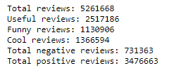
Data Exploration
First we conduct sentiment analysis based on the number of stars in reviews

Slide 6
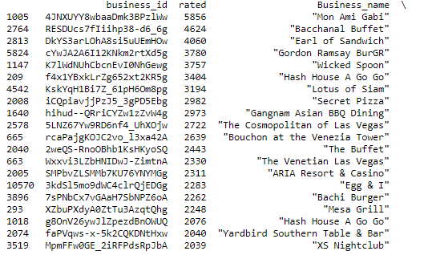
TOP REVIEWED BUSINESS⭐⭐⭐⭐⭐(3 or more)
SAMPLE OUTPUT

Slide 7
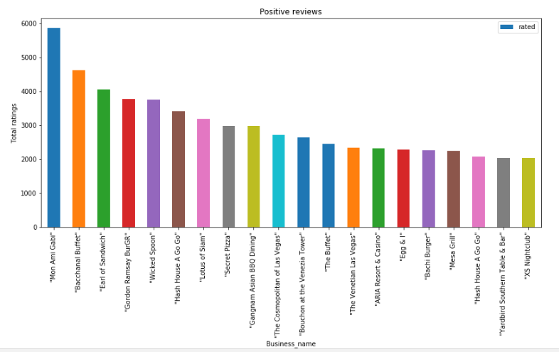
Plotting the top 20 business

Slide 8
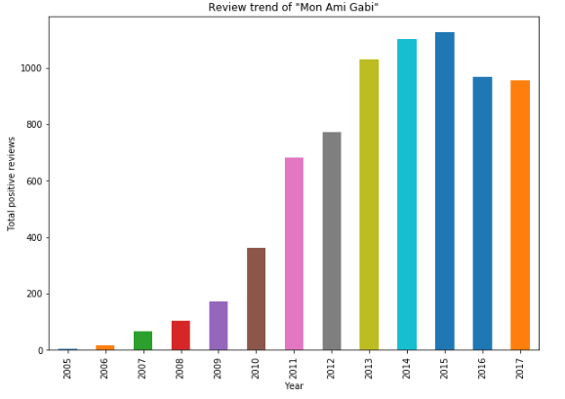
TREND ANALYSIS OF BUSINESSES
POSITIVE TREND

Slide 9
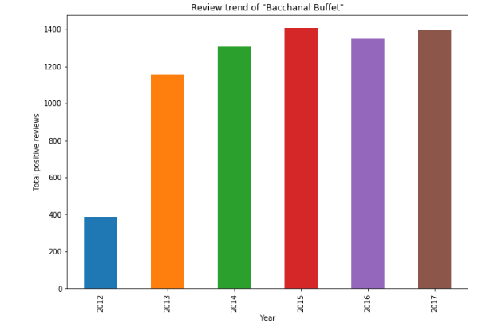
TREND ANALYSIS OF BUSINESSES
POSITIVE TREND

Slide 10
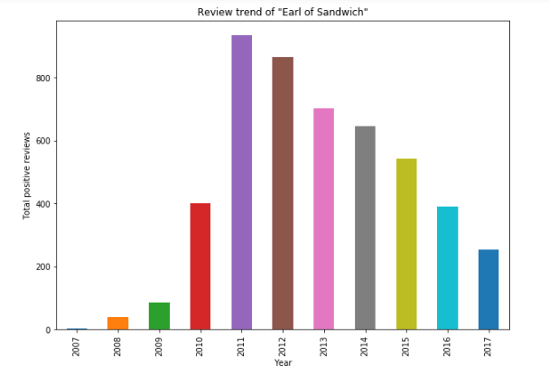
TREND ANALYSIS OF BUSINESSES
DECLINING TREND

Slide 11
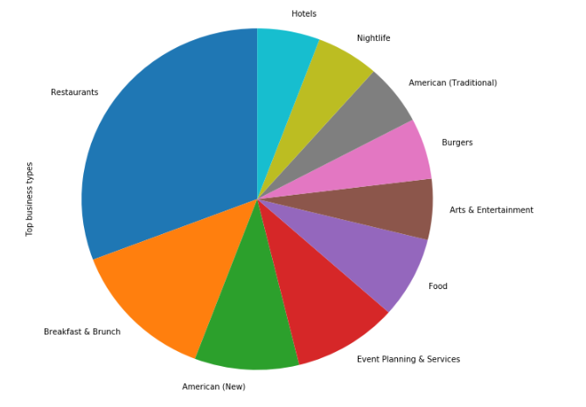
Categories of top reviewed businesses (Users like eating)

Slide 12
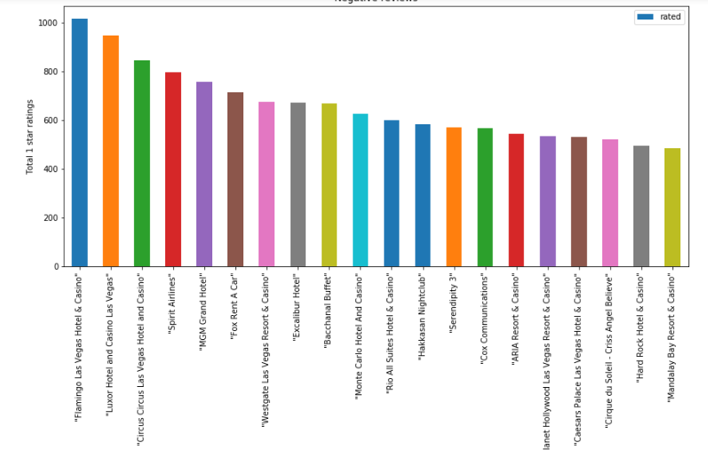
Negatively reviewed businesses

Slide 13
Finding most frequent words in Negative reviews
tokenize(s) : Convert string to lowercase and split into words (ignoring punctuation), returning list of words.
count_ngrams(lines,min_length=2,max_length=4):
Iterate through given lines iterator
return n-gram frequencies
Returned dict includes n-grams of length min_length to max_length

Slide 14
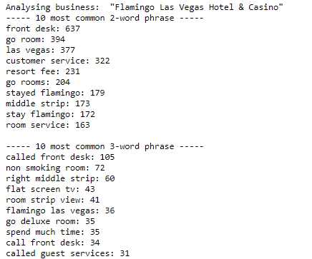
OUTPUT OF USING N-GRAM

Slide 15
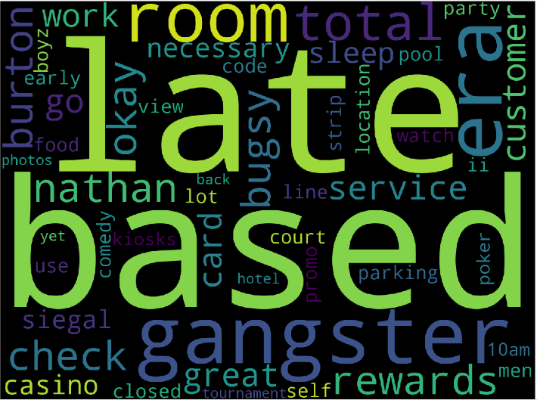
SAMPLE WORDCLOUD FOR NEGATIVE REVIEWS

Slide 16

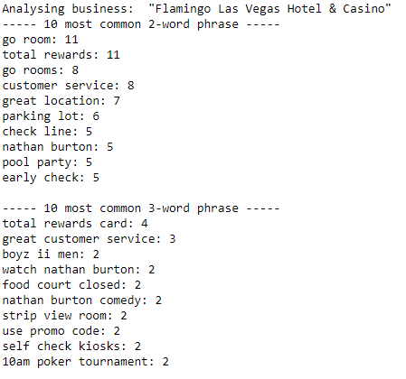
Most frequent tips
OUTPUT

Slide 17
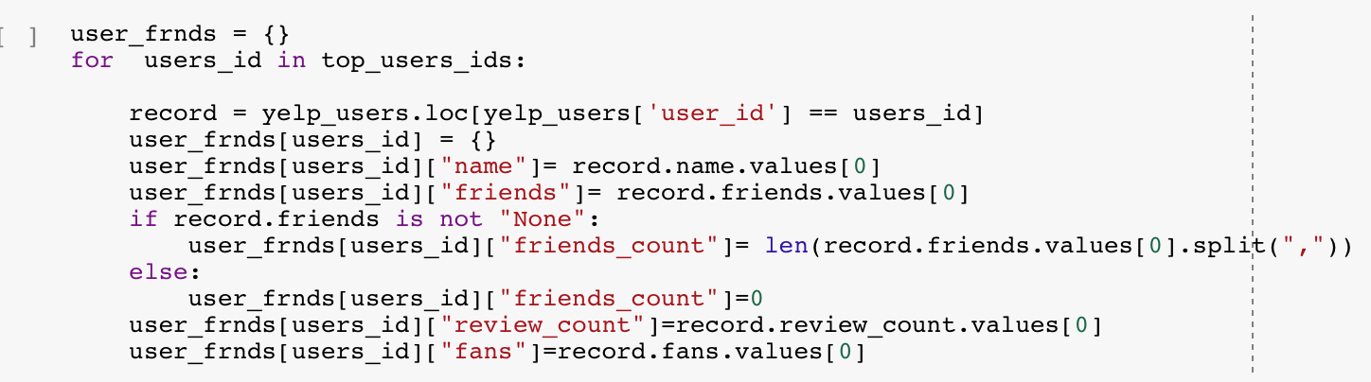
Relationship between User's Friends and review patterns
-We identified the users with most number of reviews.
- and then compare their number of reviews with the number of reviews of their friends and fans.

Slide 18
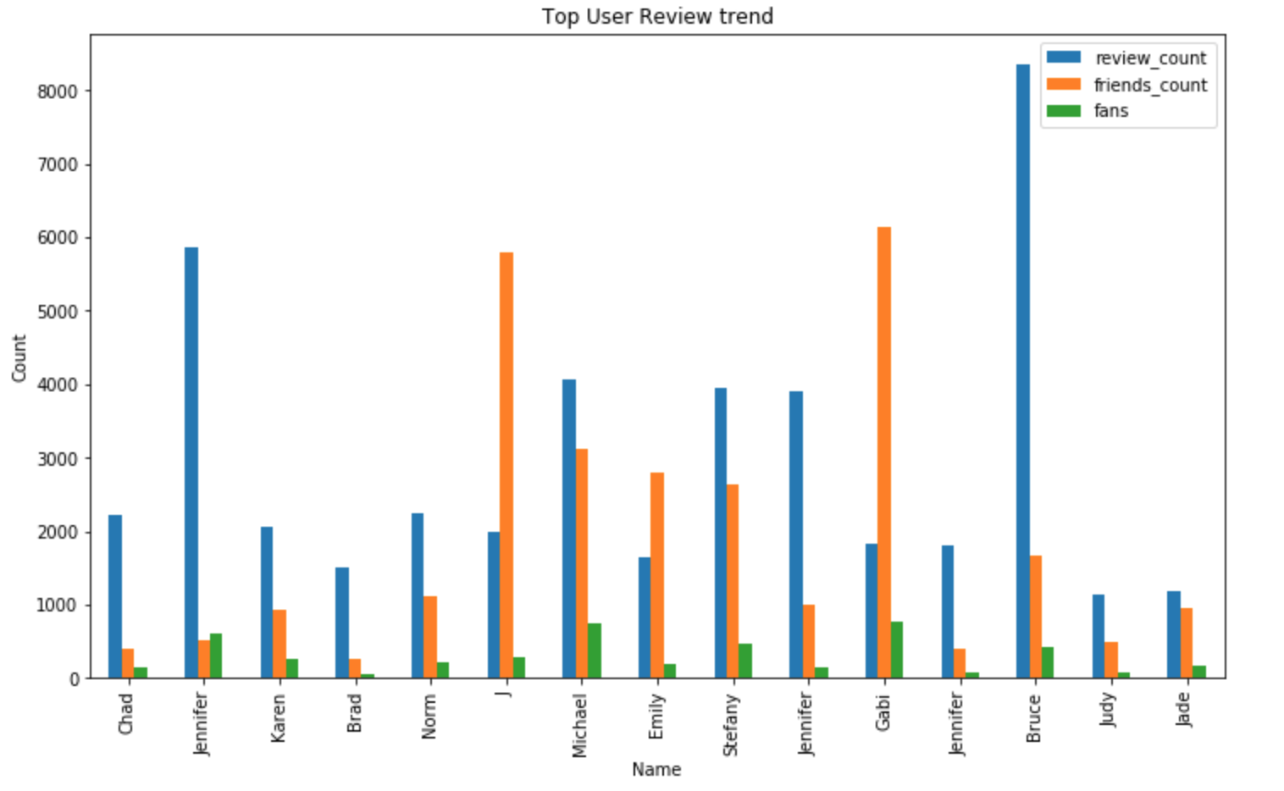
Lets see how the data looks like...

Slide 19
NLTK/ Logistic Regression .
We performed Logistic Regression on Yelp Review dataset for predicting how many stars can a business get based on the review.
We cleaned our text data and used it as our X parameter.
for Y Parameter we assigned values according to the stars given in a review- 1 or 2 stars is considered “O” and the 4 or 5 stars is considered “1”.
we first used CountVectorizer for vectorizing our reviews before applying the Logistics regression
using Countvectorizer resulted in a longer period of execution which was close to 1hr.
when we used TF-IDF Tokenizer, regression resulted in a shorter time which was close to 10 mins.

Slide 20
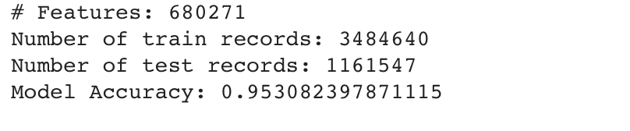

Regression Results
-With CountVectorizer
-With TF_IDF Tokenizer

Slide 21
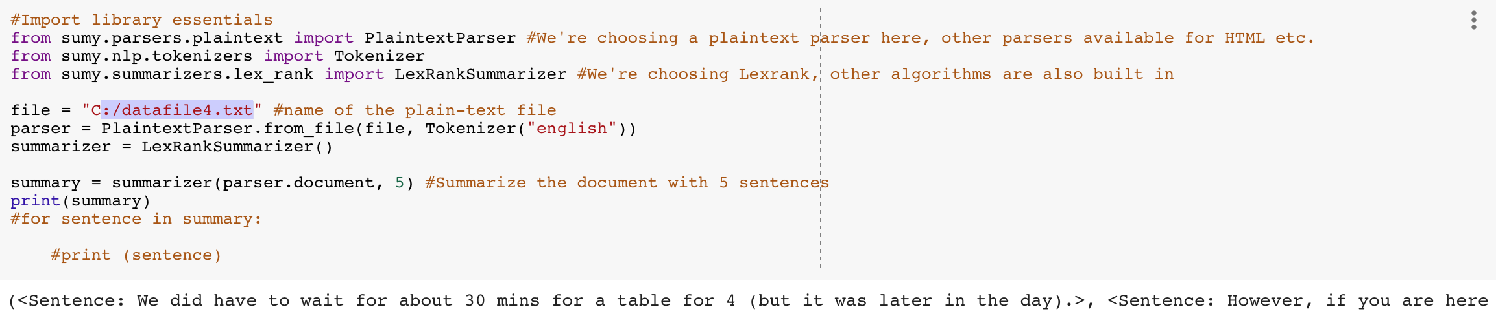
SUMY(Auto Summarization package)
We used this package to auto generate a summary of a review.
we created a function to create a summary from all the reviews provided for any business.

Slide 22
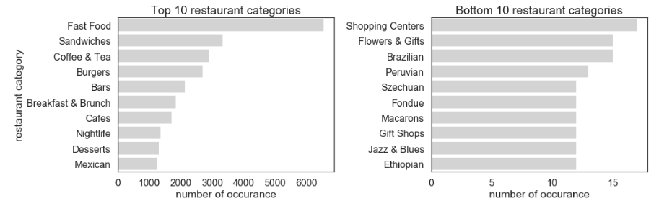
Recommendation Systems
Recommender systems are information filtering systems that deal with the problem of information overload by filtering vital information fragment out of large amount of dynamically generated information according to user’s preferences, interest, or observed behavior about item. Recommender system has the ability to predict whether a particular user would prefer an item or not based on the user’s profile.

Slide 23
Case 1:
Recommend the most popular items A simple approach could be to recommend the items which are liked by most number of users. This is a blazing fast and dirty approach and thus has a major drawback. The things is, there is no personalization involved with this approach.
Case 2:
Using a classifier to make recommendation We already know lots of classification algorithms. Let’s see how we can use the same technique to make recommendations. Classifiers are parametric solutions so we just need to define some parameters (features) of the user and the item. The outcome can be 1 if the user likes it or 0 otherwise.

Slide 24
Case 3: Recommendation Algorithms Now let us come to the special class of algorithms which are tailor-made for solving the recommendation problem. There are typically two types of algorithms – Content Based and Collaborative Filtering.
Content based algorithms: Idea: If you like an item then you will also like a “similar” item Based on similarity of the items being recommended It generally works well when it is easy to determine the context/properties of each item. For instance when we are recommending the same kind of item like a movie recommendation or song recommendation.

Slide 25
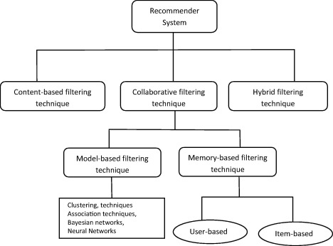

Slide 26
User-User Collaborative filtering: Here we find look alike customers (based on similarity) and offer products which first customer’s look alike has chosen in past. This algorithm is very effective but takes a lot of time and resources.
Item-Item Collaborative filtering: It is quite similar to previous algorithm, but instead of finding customer look alike, we try finding item look alike. Once we have item look alike matrix, we can easily recommend alike items to customer who have purchased any item from the store. This algorithm is far less resource consuming than user-user collaborative filtering.

Slide 27
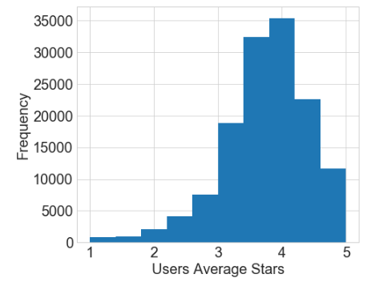

Slide 28
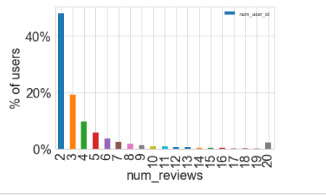

Slide 29
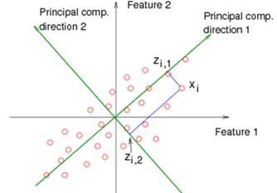
PCA
Pre-collaborative filtering
Principal Component Analysis (PCA) is used to explain the variance-covariance structure of a set of variables through linear combinations. It is often used as a dimensionality-reduction technique.

Slide 30
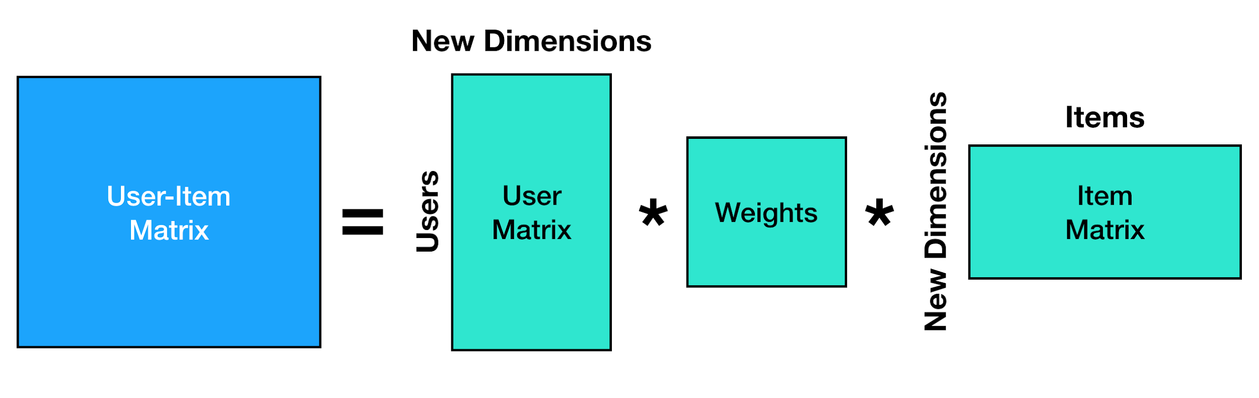
SVD - singular value decomposition
The Singular-Value Decomposition, or SVD for short, is a matrix decomposition method for reducing a matrix to its constituent parts in order to make certain subsequent matrix calculations simpler. A popular application of SVD is for dimensionality reduction. Data with a large number of features, such as more features (columns) than observations (rows) may be reduced to a smaller subset of features that are most relevant to the prediction problem.

Slide 31
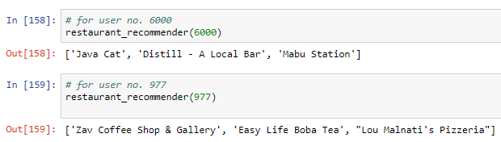
Conclusion and results
Extensive data Exploration and visualization
Text analytics techniques on reviews and ratings
Predictive modelling on text
Model accuracy 95%
Auto summarization of reviews
Building Recommendation engine

Slide 32
References
https://www.kaggle.com/ambarish/a-very-extensive-data-analysis-of-yelp
https://github.com/apropos13/Yelp-Recommendation-System

Slide 33


